Slide 1
Animal Farm about:
-- despair
-- violence
-- brutality/ cruelty/ bestiality (quite literally)
-- profit and profiteering
-- abuse of power
-- despair and hopelessness
-- abuse of religion
-- tyranny
-- selfishness
Animal Farm is a fable, a simple, concise story using animals with human characteristics (“anthropomorphized animals”) to teach a lesson or a “moral.”
And Orwell’s “lesson” is about the power of language to construct or deconstruct social order, and to control people’s responses.

Slide 2
Confucius
“Without knowing the force of words,
it is impossible to know more.”

Slide 3
Ludwig Wittgenstein
Die Grenzen meiner Sprache bedeuten die Grenzen meiner Welt.
The limits of my language mean the limits of my world. (5.6)
(The limits of my language are the limits of my mind. All I know is what I have words for.)

Slide 4
Plato
You may be sure . . . that inaccurate language is not only in itself a mistake: it implants evil in men's souls.

Slide 5
There is yet behind what I purposed to lay open, the incredible loss and detriment that this plot of licensing puts us to; more than if some enemy at sea should stop up all our havens and ports and creeks, it hinders and retards the importation of our richest merchandise, truth.
John Milton, Areopagitica, 1644

Slide 6
Form and Content
“[The English language] becomes ugly and inaccurate because our thoughts are foolish, but the slovenliness of our language makes it easier for us to have foolish thoughts . . . if thought corrupts language, language can also corrupt thought.”
“Politics and the English Language,” 1946

Slide 7
Euphemism
In our time, political speech and writing are largely the defence of the indefensible. Things like the continuance of British rule in India, the Russian purges and deportations, the dropping of the atom bombs on Japan, can indeed be defended, but only by arguments which are too brutal for most people to face, and which do not square with the professed aims of the political parties. Thus political language has to consist largely of euphemism, question-begging and sheer cloudy vagueness. Defenceless villages are bombarded from the air, the inhabitants driven out into the countryside, the cattle machine-gunned, the huts set on fire with incendiary bullets: this is called pacification. Millions of peasants are robbed of their farms and sent trudging along the roads with no more than they can carry: this is called transfer of population or rectification of frontiers. People are imprisoned for years without trial, or shot in the back of the neck or sent to die of scurvy in Arctic lumber camps: this is called elimination of unreliable elements. Such phraseology is needed if one wants to name things without calling up mental pictures of them.
(remember Harrison)

Slide 8
Clarity
Political language-and with variations this is true of all political parties, from Conservatives to Anarchists -- is designed to make lies sound truthful and murder respectable, and to give an appearance of solidity to pure wind. One cannot change this all in a moment, but one can at least change one's own habits. And from time to time one can even, if one jeers loudly enough, send some worn-out phrase – some jackboot, Achilles heel, hotbed, melting pot, acid test, veritable inferno, or other lump of verbal refuse – into the dustbin where it belongs.

Slide 9
Clarity
The great enemy of clear language is insincerity. When there is a gap between one’s real and one’s declared aims, one turns as it were instinctively to long words and exhausted idioms, like a cuttlefish squirting out ink. In our age there is no such thing as ‘keeping out of politics’. All issues are political issues, and politics itself is a mass of lies, evasions, folly, hatred and schizophrenia.

Slide 10
Simplicity
Now that I have made this catalogue of swindles and perversions, let me give another example of the kind of writing that they lead to. This time it must of its nature be an imaginary one. I am going to translate a passage of good English into modern English of the worst sort. Here is a well-known verse from Ecclesiastes: I returned and saw under the sun, that the race is not to the swift, nor the battle to the strong, neither yet bread to the wise, nor yet riches to men of understanding, nor yet favour to men of skill; but time and chance happeneth to them all. Here it is in modern English: Objective considerations of contemporary phenomena compel the conclusion that success or failure in competitive activities exhibits no tendency to be commensurate with innate capacity, but that a considerable element of the unpredictable must invariably be taken into account.”

Slide 11
Historical Revision
The organized lying practiced by totalitarian states is not, as is sometimes claimed, a temporary expedient of the same nature as military deception. It is something integral to totalitarianism, something that would still continue even if concentration camps and secret police forces had ceased to be necessary. Among intelligent Communists there is an underground legend to the effect that although the Russian government is obliged now to deal in lying propaganda, frame-up trials, and so forth, it is secretly recording the true facts and will publish them at some future time. We can, I believe, be quite certain that this is not the case, because the mentality implied by such an action is that of a liberal historian who believes that the past cannot be altered and that a correct knowledge of history is valuable as a matter of course. From the totalitarian point of view history is something to be created rather than learned. A totalitarian state is in effect a theocracy, and its ruling caste, in order to keep its position, has to be thought of as infallible. But since, in practice, no one is infallible, it is frequently necessary to rearrange past events in order to show that this or that mistake was not made, or that this or that imaginary triumph actually happened.

Slide 12
The most effective way to destroy people is to deny and obliterate their own understanding of their history.
1984
(do you think this is also a definition of “the colonial project”?)

Slide 13
"Who controls the past controls the future; who controls the present controls the past."

Slide 14
“Alternative facts”

Slide 15
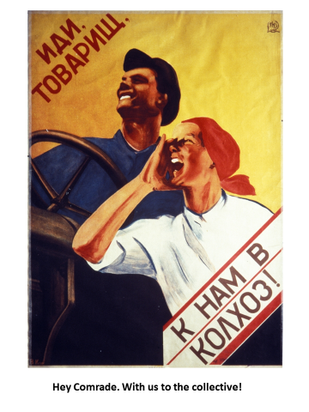

Slide 16
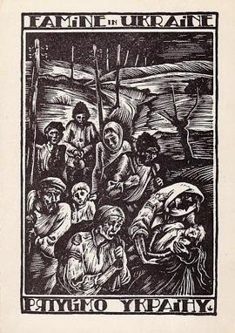

Slide 17
After this they went back to the farm buildings,
where Snowball and Napoleon sent for a ladder which
they caused to be set against the end wall of the
big barn. They explained that by their studies of the
past three months the pigs had succeeded in
reducing the principles of Animalism to seven
commandments. These seven commandments would
now be inscribed on the wall; they would form an
unalterable law by which the animals on Animal Farm
must live for ever after. . . .The commandments were
written on the tarred wall in great white letters that
could be read thirty yards away.
15

Slide 18
After much thought Snowball declared that the Seven
Commandments could in effect be reduced to a single .
maxim, namely: ‘Four legs good, two legs bad.’ This,
he said, contained the essential principle of Animalism.
Notes:
Read pp 20- 1 to indicate the effect of illiteracy on social power. Then go to 36-38 to note the connection between control of language and naked power.

Slide 19
. . .and tried to puzzle out the Seven Commandments
Which were inscribed there. Finding herself unable to
read more than individual letters, she fetched Muriel.
45
About this time, there occurred a strange incident
which hardly anyone was able to understand.
73
For the time being, certainly, it had been found necessary to make a readjustment of rations (Squealer always spoke of it as a “readjustment,” never as a “reduction”). . .
75

Slide 20
Poem: “Comrade Napoleon,” 63

Slide 21
Twelve voices were shouting in anger, and they were all alike. No question now, what had happened to the faces of the pigs. The creatures looked from pig to man, and from man to pig, and from pig to man again: but already it was impossible to say which was which.
95

Slide 22
Boxer: ‘If Comrade Napoleon says it, it must be right.’
And from then on, he adopted the maxim, ‘Napoleon
is always right,’ in addition to his private motto of
‘I will work harder.’
38
Notes:
Go to p. 47-8 and 52-3, and 54 for example of control of past. Squealer’s role – Pravda. And 56-7 for show trials.

Slide 23
Without waiting for orders from the pig, the animals
broke off work and raced back to the farm buildings .. . .
81

Slide 24
“Power is not a means, it is an end. One does not establish a dictatorship to safeguard a revolution; one makes a revolution in order to establish a dictatorship. The object of persecution is persecution. The object of torture is torture. The object of power is power.“

